Slide 1


Department of Computer Engineering
Online Application for Training and Placement Dept. of College
Presented by : 1 . Vishwakarma Chandan
2 .Tiwari Shivam 3 .Tiwari Devesh 4.Tiwari Vishal
Guide: Mrs. Harsha Dave

Slide 2
1.Abstract 2.Motivation 3.Objectives
Introduction
Literature Survey
Features of Proposed system 7.Proposed Architecture
Expected Results and Discussion
Conclusion 10.References

Slide 3

Abstract
The proposed online application for the training and placement department of a college aims to streamline the placement process by automating student profile management, company-student matching, and training modules. This system addresses the inefficiencies of existing manual processes, offering real-time updates and data-driven insights. It enhances accuracy and reduces administrative workload, resulting in improved placement outcomes. The user-friendly interface ensures accessibility for all users. Future enhancements may include AI-driven predictive analytics to further optimize placement success.

Slide 4
Motivation
The "Online Application for Training and Placement Dept. of College" project aims to improve the management of training and placement activities by replacing inefficient manual processes with an automated solution. This project seeks to enhance operational efficiency, reduce administrative burdens, and improve the accuracy of tracking and reporting, ultimately supporting student career development and success in a competitive job market.
Societal Impact: The web app addresses the pressing need for improving student employability by bridging the gap between academia and industry, facilitating smooth transitions from education to employment.
Technological Impact:By leveraging modern web technologies, the app provides a scalable solution that integrates seamlessly with existing academic systems, offering real-time updates and training.

Slide 5

Objective
The "Online Application for Training and Placement Dept. of College" project aims to streamline training and placement management by simplifying the scheduling of programs, managing resources, and delivering content efficiently. It will also enable the tracking of student progress and placement activities while generating detailed reports and metrics for insightful analysis. These enhancements are designed to improve overall efficiency and support better student outcomes
The system will:
Handle Registrations: Facilitate sign-ups and track attendance.
Deliver Content: Upload and manage training materials.
Collect Feedback: Gather participant evaluations.
Generate Reports: Provide automated insights and dashboards.

Slide 6

Introduction
Overview:
The management of training and placement activities in educational institutions often
involves manual processes that are inefficient and error-prone. This project introduces an online application designed to automate and streamline these tasks, providing a centralized solution for managing training programs and tracking placement activities.
Enhance Efficiency: Simplify scheduling, resource allocation, and content
delivery.
Improve Tracking: Monitor student progress and placement status in real time. Enable Insights: Generate detailed reports for better decision-making and strategic planning.
Impact: By replacing outdated manual systems with a robust digital platform, this
project aims to boost operational efficiency, reduce errors, and support effective student career development.

Slide 7
TOOLS AND TECHNOLOGY
-UI/UX Design: Created wireframes and prototypes with a minimalist and intuitive design.
HTML/CSS: Developed the HTML structure with semantic markup and applied CSS for styling, color gradients, and responsive design.
JavaScript: Added interactivity through dynamic content, form validation, modals, and dropdowns.

Slide 8
For Backend Development:
Database Design: Structured MySQL database with efficient data storage and integrity.
Server-Side Scripting: Implemented server-side scripts for data processing, authentication, and CRUD operations.
Integration: Connected frontend and backend using APIs.
Security: Applied data encryption and input validation for protection.

Slide 9

IMPLEMENTATION/TESTING
DEVELOPMENTAL PHASE
Frontend Development:
Completed using HTML, CSS, JavaScript, and Bootstrap. Responsive design ensures compatibility across devices.
Cross-Browser Compatibility:
Tested for consistent performance across Chrome, Firefox, Safari, and Edge.
UI and Functionality Testing:
Validated layout, interactive elements, and form submissions. Ensured dynamic features work as intended on various devices.
Bug Fixing and Optimization:
Identified and resolved layout, performance, and functionality issues. Optimized code for faster loading and improved performance.

Slide 10
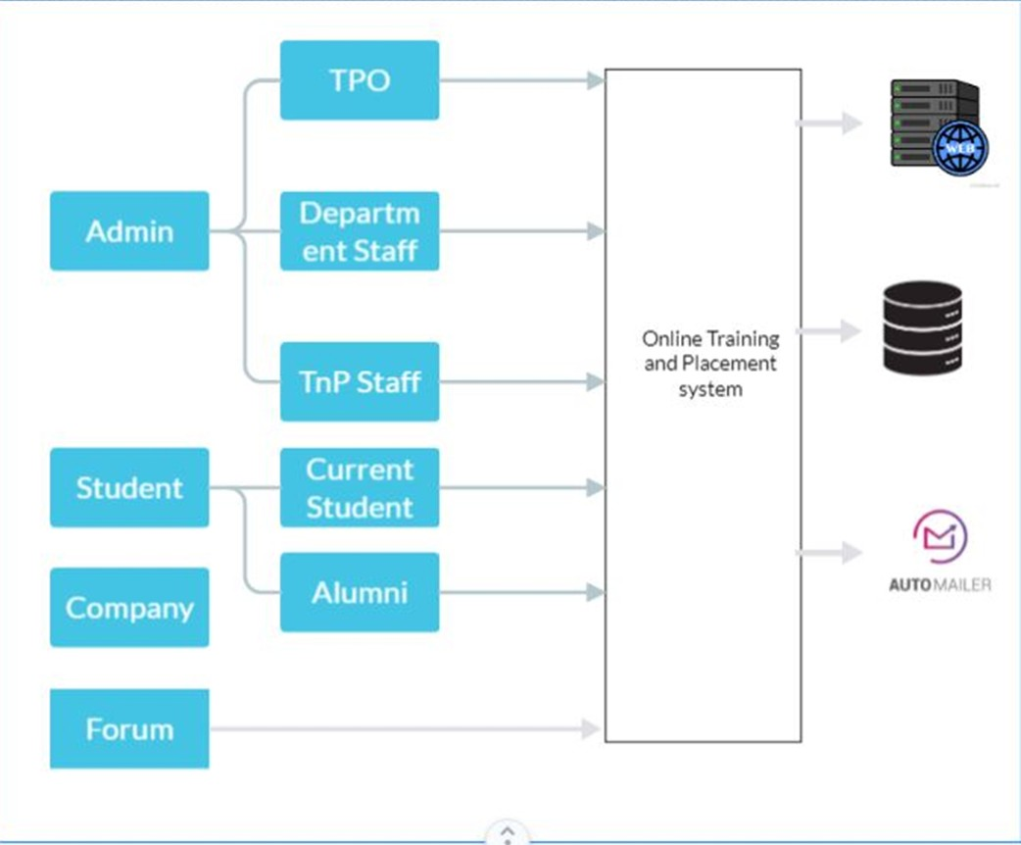
Proposed system

Slide 11
Proposed system
Features of Proposed System Program Scheduling:
Integrated Calendar: Schedule training sessions, workshops, and seminars with automated reminders and conflict resolution.
Resource Management:
Instructor Assignment: Assign and schedule instructors based on availability and expertise.
Participant Management:
Online Registration: Enable easy sign-ups, track attendance, and manage cancellations.
Content Delivery:
Content Repository: Upload, organize, and access training materials and resources. Interactive Features: Include quizzes, polls, and discussion forums to engage participants.

Slide 12
Content Delivery:
Content Repository: Upload, organize, and access training materials and resources. Interactive Features: Include quizzes, polls, and discussion forums to engage participants.
Tracking and Monitoring:
Progress Tracking: Record and monitor student progress and placement status. Real-Time Updates: Ensure accurate and up-to-date information on student career development.
Feedback and Evaluation:
Survey Tools: Collect feedback from participants through customizable surveys and evaluation forms.
Performance Metrics: Analyze feedback and track performance to assess program effectiveness.
Reporting and Analytics:
Automated Reports: Generate reports on training and placement metrics.
Custom Dashboards: Access customizable dashboards for real-time insights and data analysis.

Slide 13
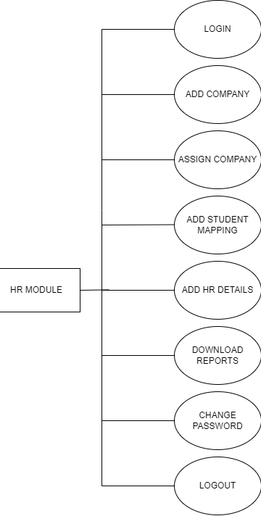
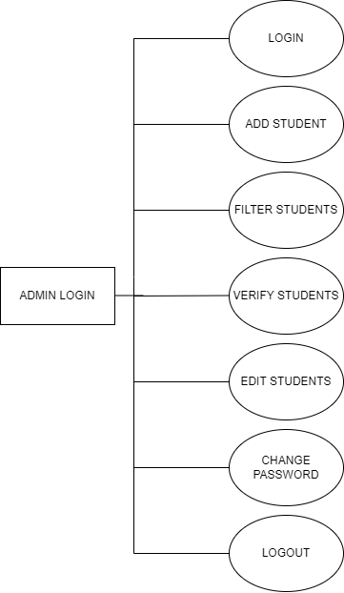
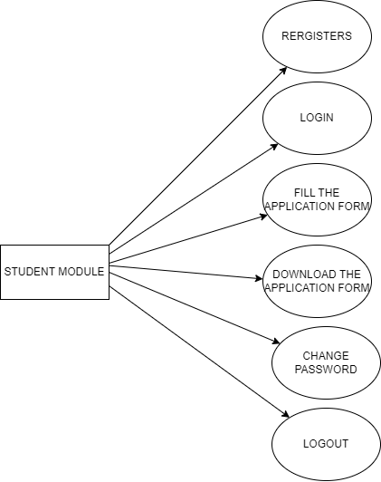
ARCHITECTURE SYSTEM

Slide 14
LITERATURE SURVEY
The manual training and placement system at Sanjay Ghodawat Institute (SGI) causes delays in managing student details and company notifications. To resolve this, an automated app is being developed to streamline these processes, allowing students and TPOs to efficiently manage placement activities through an Android app.
The project aims to create a web-based placement management system for a college on Windows, enabling the placement department to store and manage student details. Students can upload their information, and the system helps the college track placements, reducing manual work and paperwork.
The web portal automates the placement cell's processes by storing and managing students' personal, academic, and skill information. Students can apply for jobs and update their details, while T&P officers can filter candidates, access data, and notify students about placement activities.
LIINKS:

Slide 15
Expected Results and Discussion
Increased Operational Efficiency:
Result: Automation of manual processes will significantly speed up data management and placement activities.
Discussion: Reduces processing time by up to 50%, minimizes manual errors, and allows T&P officers to focus on strategic tasks rather than administrative work.
Enhanced Data Accuracy and Accessibility:
Result: Centralized database will improve the accuracy and accessibility of student and placement information.
Discussion: Ensures data consistency, reduces entry errors, and provides real-time updates, leading to more reliable tracking and reporting.
Higher Student Engagement and Satisfaction:
Result: User-friendly web portal will boost student participation in placement activities and job applications.
Discussion: Improved interface and ease of access are expected to increase student engagement , enhancing overall satisfaction and preparation for job opportunities.

Slide 16

CONCLUSION
The development of an automated training and placement web application addresses the challenges faced by manual systems, such as delays, data inaccuracies, and inefficient communication. By streamlining the management of student details and placement activities, this solution enhances operational efficiency, improves data accuracy, and boosts student engagement. The implementation of this system at SHREE .LR. TIWARI COLLEGE OF ENGINEERING will lead to a more organized, transparent, and effective placement process, ultimately benefiting students, T&P officers, and recruiters alike.

Slide 17

REFERENCES
"TnP Vision: Automation and Analysis of Campus Placements in Colleges" - This paper discusses an ERP system for automating the entire placement process in educational institutions.
Access it on IEEE Xplore “https://ieeexplore.ieee.org/document/9465519".
"Web Based Automation of Training and Placement Cell" - A paper focusing on automating the manual tasks of a placement cell, enhancing efficiency and accuracy.
Available on IJSER
“https://www.ijser.org/researchpaper/Web-Based-Automation-Of-Training-And-Placement-Cell.pdf”. "Online Training and Placement Management System" - Discusses a web-based system designed to manage placement activities and student data effectively.
Access it on IJERT
“https://www.ijert.org/research/online-training-and-placement-management-system-IJERTCONV4IS22035.pdf”.

